Slide 1
SRM INSTITUTE OF SCIENCE AND TECHNOLOGY, CHENNAI
ARTIFICIAL NEURAL NETWORKS
UNIT - V
Department: AIML-B,C
Staff Name: L.Sasikala

Slide 2
Unit – V
Unsupervised learning network paradigms
Self-organizing maps (SOM)
Structure
Functionality and output interpretation
Training
Variations
Neural gas
Multi SOMs
Multi Neural gas
Growing neural gas
Adaptive resonance theory(ART)
Task and structure of an ART network
Resonance
Learning process of an ART network

Slide 3
Introduction:
If you take a look at the concepts of biological neural networks, one question will arise:
How does our brain store and recall the impressions it receives every day.
The brain does not have any training samples and therefore no "desired output".
Our brain responds to external input by changes in state.
Based on this principle and exploring the question of how biological neural networks organize themselves, Teuvo Kohonen developed in the Eighties his self- organizing feature maps, shortly referred to as Self-Organizing Maps or SOMs.
A paradigm of neural networks where the output is the state of the network, which learns completely unsupervised, i.e. without a teacher.
The brain has to organize and create itself for the most part.

Slide 4
A self-organizing map (SOM) is a type of artificial neural network (ANN) that is trained using unsupervised learning to produce a low-dimensional (typically two-dimensional), discretized representation of the input space of the training samples, called a map, and is therefore a method to do dimensionality reduction.
Self-organizing maps differ from other artificial neural networks as they apply competitive learning as opposed to error-correction learning (such as backpropagation with gradient descent), and in the sense that they use a neighborhood function to preserve the topological properties of the input space.

Slide 5
Unlike the other network paradigms we have already got to know, for SOMs it is unnecessary to ask what the neurons calculate.
We only ask which neuron is active at the moment.
The purpose of SOM is that it’s providing a data visualization technique that helps to understand high dimensional data by reducing the dimension of data to map.
SOM also represents the clustering concept by grouping similar data together.
Therefore it can be said that Self Organizing Map reduces data dimension and displays similarly among data.

Slide 6
Competitive Learning:
A form of unsupervised training where output units are said to be in competition for input patterns.
During training, the output unit that provides the highest activation to a given input pattern is declared the weights of the winner and is moved closer to the input pattern, whereas the rest of the neurons are left unchanged.
This strategy is also called winner-take-all since only the winning neuron is updated.
Output units may contain lateral inhibitory connections, allowing a winner neuron to suppress others in proportion to its level of activation.

Slide 7
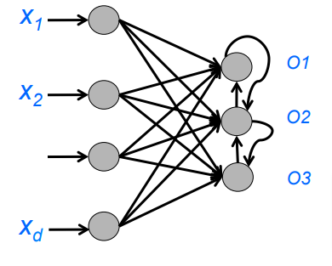
Competitive learning

Slide 8
Structure:
Typically, SOMs have – like our brain – the task to map a high-dimensional input (N dimensions) onto areas in a low-dimensional grid of cells (G dimensions) to draw a map of the high-dimensional space.
To generate this map, the SOM simply obtains arbitrary many points of the input space.
During the input of the points, the SOM will try to cover as good as possible the positions on which the points appear by its neurons.
This particularly means, that every neuron can be assigned to a certain position in the input space.

Slide 9
There are two spaces in which SOMs are working:
The N -dimensional input space and
The G-dimensional grid on which the neurons are lying and which indicates the neighborhood relationships between the neurons and therefore the network topology.
In a one-dimensional grid, the neurons could be, for instance, like pearls on a string.
Every neuron would have exactly two neighbors (except for the two end neurons).
A two-dimensional grid could be a square array of neurons.
Another possible array in two-dimensional space would be some kind of honeycomb shape.
Irregular topologies are possible, too, but not very often.
Topologies with more dimensions and considerably more neighborhood relationships would also be possible, but due to their lack of visualization capability they are not employed very often.

Slide 10
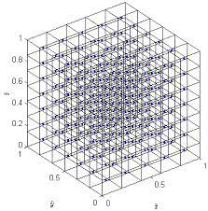

Slide 11
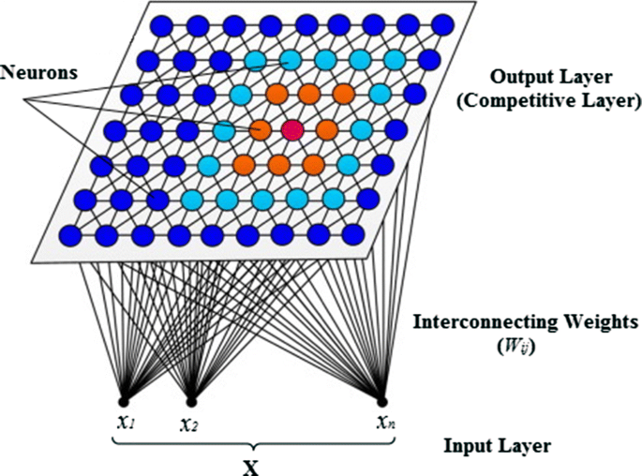

Slide 12
Self-organizing maps, unlike supervised ANN, comprises of input and output neurons with no hidden layers and are developed in such a way that only one of the output neurons can be activated.
It concludes competitive learning, a procedure where all the output neurons compete with each other.
The winner of such competition is fired and referred to as the winning neuron, BMU.
Best Matching Unit
Is a technique which calculates the distance from each weight to the sample vector, by running through all weight vectors.
The weight with the shortest distance is the winner.
There are numerous ways to determine the distance, however, the most commonly used method is the Euclidean distance.

Slide 13
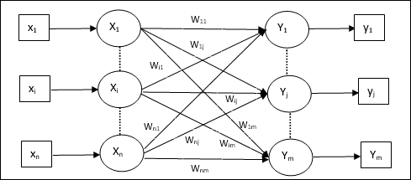
Architecture:
The architecture of KSOM is similar to that of the competitive network.
The training can take place over the extended region of the network.

Slide 14
Unsupervised ANNs Algorithms and Techniques:
Techniques and algorithms which are used in unsupervised ANNs involve self-organizing maps, restricted Boltzmann machines, autoencoders, etc.
SOM neuron:
Similar to the neurons in an RBF network a SOM neuron k does not occupy a fixed position c_{k} (a center ) in the input space.
Self-organizing map:
A self-organizing map is a set K of SOM neurons.
If an input vector is entered, exactly that neuron k ∈ K is activated which is closest to the input pattern in the input space.
The dimension of the input space is referred to as N .

Slide 15
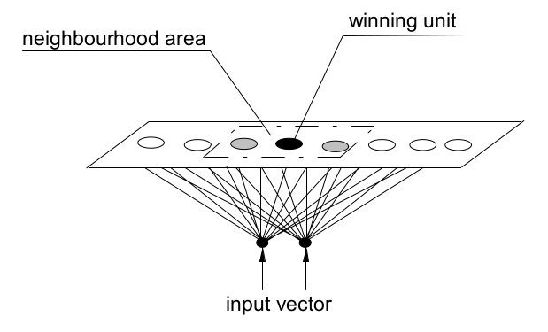
Topology:
The neurons are interconnected by neighborhood relationships.
These neighborhood relationships are called topology.
The training of a SOM is highly influenced by the topology.
It is defined by the topology function h(i, k, t), where i is the winner neuron, k the neuron to be adapted and t the time step.
The dimension of the topology is referred to as G.

Slide 16
Functionality and output interpretation:
SOMs always activate the neuron with the least distance to an input pattern.
The SOM functionality consists of the following steps:
Input of an arbitrary value p of the input space R^{N} .
Calculation of the distance between every neuron k and p by means of a norm, i.e. calculation of ||p − c_{k}||.
One neuron becomes active, namely such neuron i with the shortest calculated distance to the input.
All other neurons remain inactive.
This paradigm of activity is also called winner-takes-all scheme.
The output we expect due to the input of a SOM shows which neuron becomes active.

Slide 17
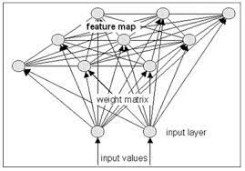
Often an input layer is described that is completely linked towards an SOM layer.
Then the input layer (N neurons) forwards all inputs to the SOM layer.
The SOM layer is laterally linked in itself so that a winner neuron can be established and inhibit the other neurons.

Slide 18
Initialization:
The network starts with random neuron centers from the input space.
Creating an input pattern:
A stimulus, i.e. a point p, is selected from the input space, now the stimulus is entered into the network.
Distance measurement:
The distance determined for every neuron k in the network.
Winner takes all:
The winner neuron i is determined, which has the smallest distance to p, i.e. which fulfills the condition
from several winner neurons one can be selected at will.
Adapting the centers:
The neuron centers are moved within the input space according to the rule

Slide 19
where the values ∆c_{k} are simply added to the existing centers.
The last factor shows that the change in position of the neurons k is proportional to the distance to the input pattern p and, as usual, to a time- dependent learning rate η(t).
SOM learning rule
A SOM is trained by presenting an input pattern and determining the associated winner neuron.
The winner neuron and its neighbor neurons, which are defined by the topology function, then adapt their centers according to the rule

Slide 20
Topology function
The topology function h is not defined on the input space but on the grid and represents the neighborhood relationships between the neurons, i.e. the topology of the network.
It can be time-dependent which explains the parameter t.
The parameter k is all the neurons, and the parameter i is the winner neuron.
The topology function must be uni-modal, i.e. it must have exactly one maximum.
This maximum must be next to the winner neuron i, for which the distance to itself certainly is 0.
On a two-dimensional grid we could apply, for instance, the Euclidean distance or on a one-dimensional grid we could simply use the number of the connections between the neurons i and k.

Slide 21
The topology function h(i, k, t) describes the neighborhood relationships in the topology.
It can be any uni-modal function that reaches its maximum when i = k gilt.
Time-dependence is optional, but often used.

Slide 22
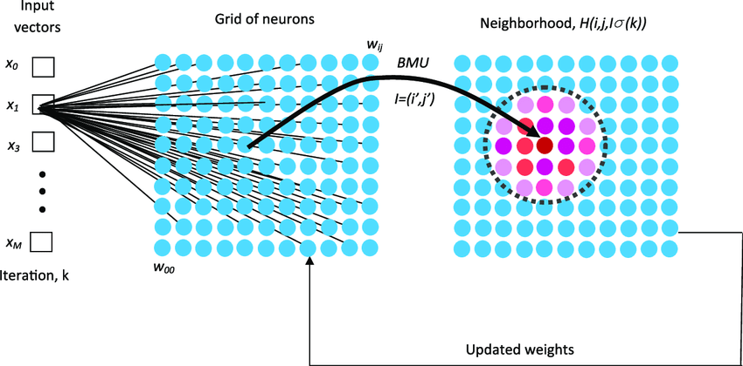

Slide 23
Introduction of common distance and topology functions
A common distance function would be, Gaussian bell.
It is uni-modal with a maximum close to 0.
Its width can be changed by applying its parameter σ , which can be used to realize the neighborhood being reduced in the course of time.
We simply relate the time-dependence to the σ and the result is a monotonically decreasing σ(t).
Then our topology function could look like this:
where g_{i} and g_{k} represent the neuron positions on the grid, not the neuron positions in the input space, which would be referred to as c_{i} and c_{k}.
Other functions that can be used instead of the Gaussian function are, for instance, the cone function, the cylinder function or the Mexican hat function.

Slide 24
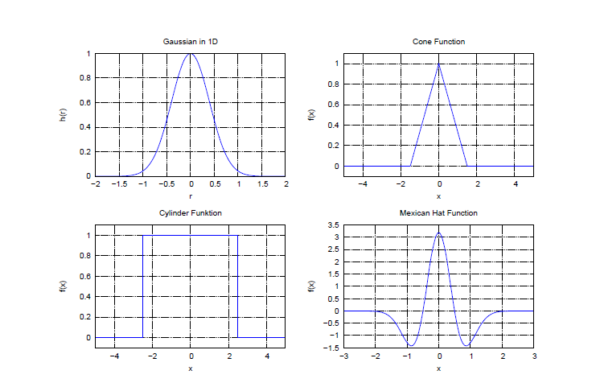

Slide 26
Learning rates and neighborhoods can decrease monotonically over time:
The SOMs often work with temporally monotonically decreasing learning rates and neighborhood sizes.
Typical sizes of the target value of a learning rate are two sizes smaller than the initial value, e.g could be true.
But this size must also depend on the network topology or the size of the neighborhood.
The advantage of a decreasing neighborhood size is that in the beginning a moving neuron "pulls along" many neurons in its vicinity, i.e. the randomly initialized network can unfold fast and properly in the beginning.
In the end of the learning process, only a few neurons are influenced at the same time which stiffens the network as a whole but enables a good "fine tuning" of the individual neurons.
It must be noted that
h · η ≤ 1
must always be true.

Slide 27
Application of SOM - World poverty map:
A SOM has been used to classify statistical data describing various quality of life factors such as state of health, nutrition, educational services etc.
Countries with similar quality of life end up clustered together.
The countries with better quality of life are situated towards the upper left and the most poverty stricken countries are towards the lower right.
Such maps can be colored using a SOM, since we can take the colors that the SOM chose for each group and apply it to our world map.
In this case, we got the data set from the World Bank containing all 39 indicators of human development, processed them into a SOM, and then applied that to a world map.

Slide 28
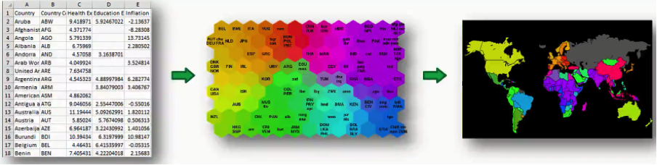

Slide 29
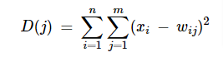
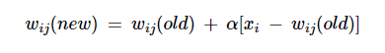
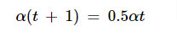
Algorithm on training:
Step 1 − Initialize the weights, the learning rate α and the neighborhood topological scheme.
Step 2 − Continue step 3-9, when the stopping condition is not true.
Step 3 − Continue step 4-6 for every input vector x.
Step 4 − Calculate Square of Euclidean Distance for j = 1 to m
Step 5 − Obtain the winning unit j where D(j) is minimum.
Step 6 − Calculate the new weight of the winning unit by the following relation
Step 7 − Update the learning rate α by the following relation
Step 8 − Reduce the radius of topological scheme.
Step 9 − Check for the stopping condition for the network.

Slide 30
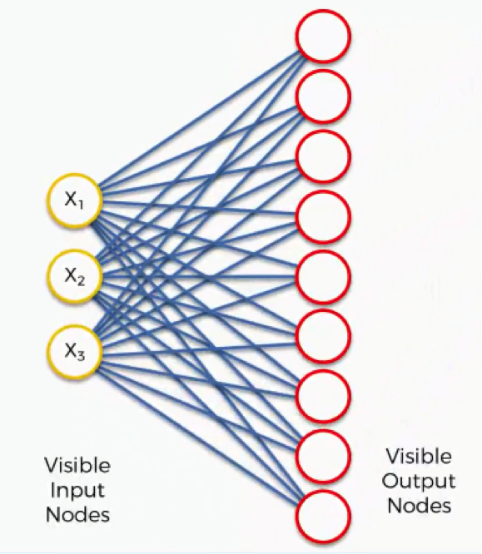
How do Self-Organizing Maps Learn?
Our input vectors amount to three features, and we have nine output nodes.

Slide 31
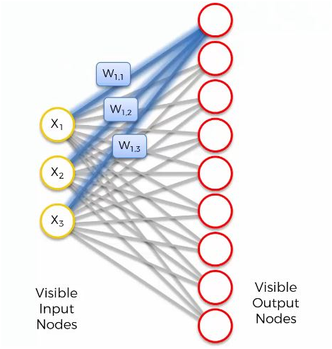
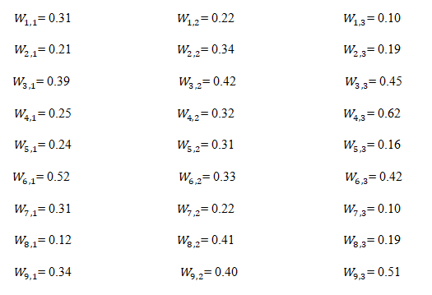
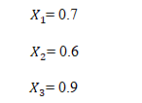

Slide 32
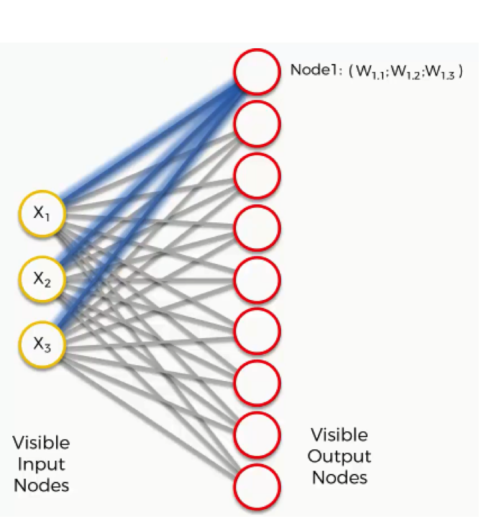
Let's take the topmost output node and focus on its connections with the input nodes.
There is a weight assigned to each of these connections.

Slide 33
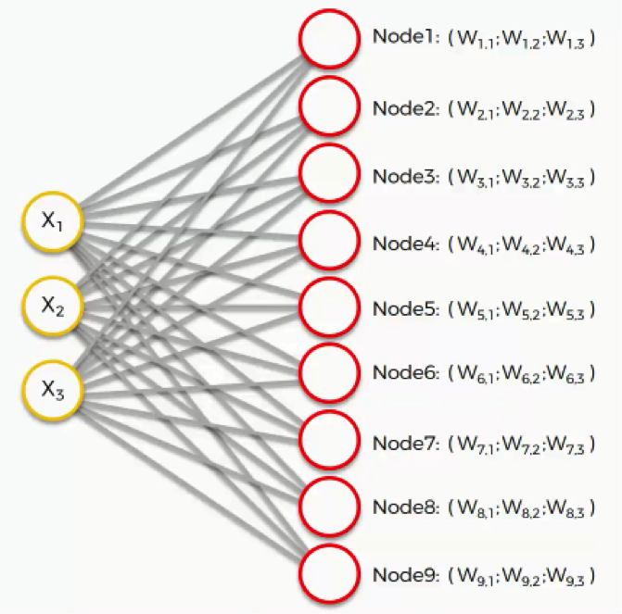
For instance, with artificial neural networks we multiplied the input node's value by the weight and, finally, applied an activation function.
With SOMs, on the other hand, there is no activation function.

Slide 34
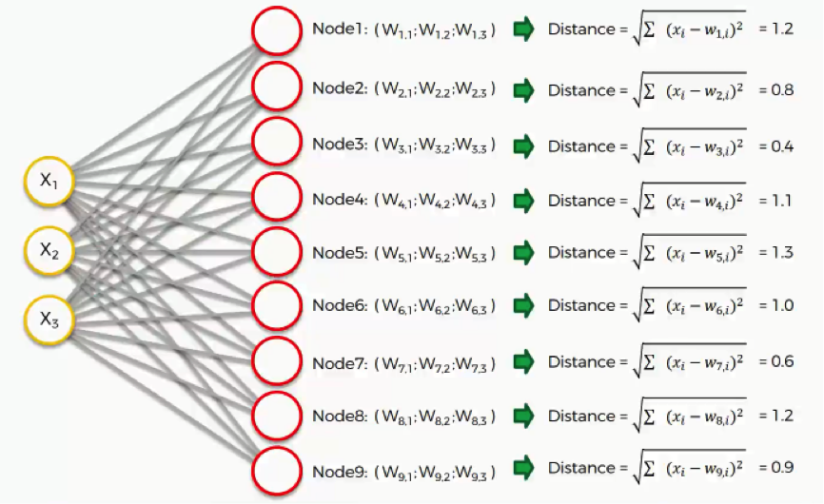
For each of the rows in our dataset, we'll try to find the node closest to it.
We'll then want to find which of our output nodes is closest to that row.
As we can see, node number 3 is the closest with a distance of 0.4.
We will call this node our BMU (Best-matching unit).

Slide 35
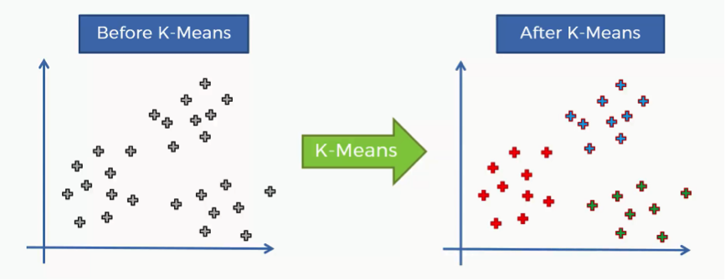
How does the K-means method work?
The K-means process begins with a scatter plot.
This chart represents are two variables depicted on the X- and Y-axes.
How do we identify the categories using this data?
That's where the K-means algorithm comes into play.
It helps us to identify the categories more easily as we can see in the image below.

Slide 36
Step One: Choose the number of clusters.
Before processing the dataset into categories, the number of clusters has to be agreed upon.
We'll agree on 2 as the number of our clusters.
That means that K=2.
Step Two: Randomly select K points to act as centroids (data point).
If you have a scatter plot like the one we examined earlier, all we need to do is choose a random (x,y) point.
It doesn't necessarily have to be one of the observation plots from our dataset.
Literally, any x-y value would do.
The most important thing is that we need as many centroids as clusters.

Slide 37
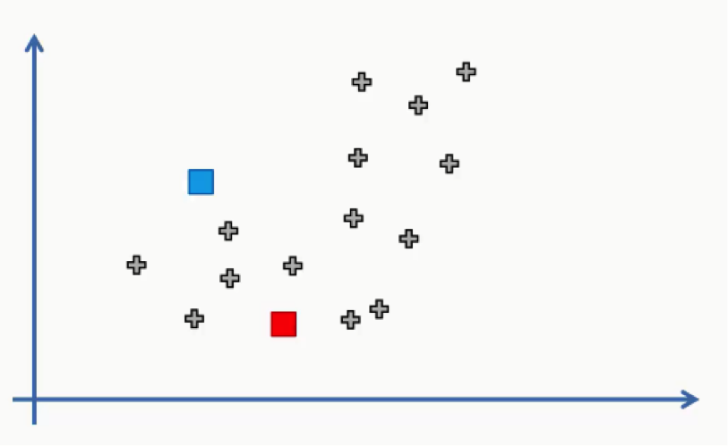
Step Three: Assign each data point to the centroid closest to it.
This is how you actually form K clusters.
As the data points are assigned to their centroids, the clusters emerge around these centroids.
We'll draw a straight line between the two centroids, then a perpendicular line right at the middle of this straight line.

Slide 38
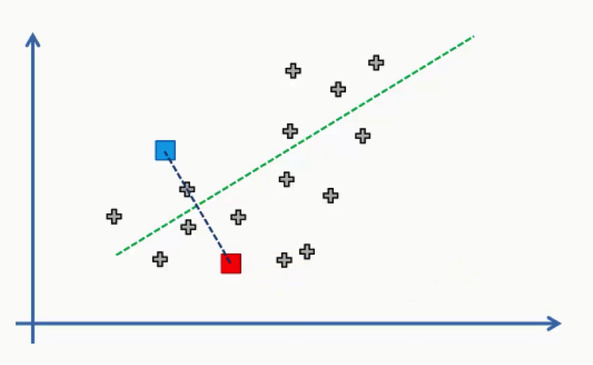
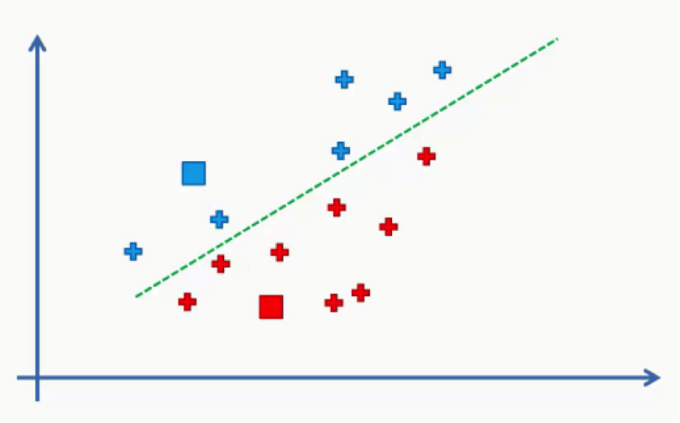
As we can see from the figure above, any data point falling above the green line is closer to the blue centroid, whereas any point beneath it is closer to the red one.
We then color our data points by the colors of their centroids.
Step Four: Compute and place the new centroid of each cluster.
As we did earlier.

Slide 39
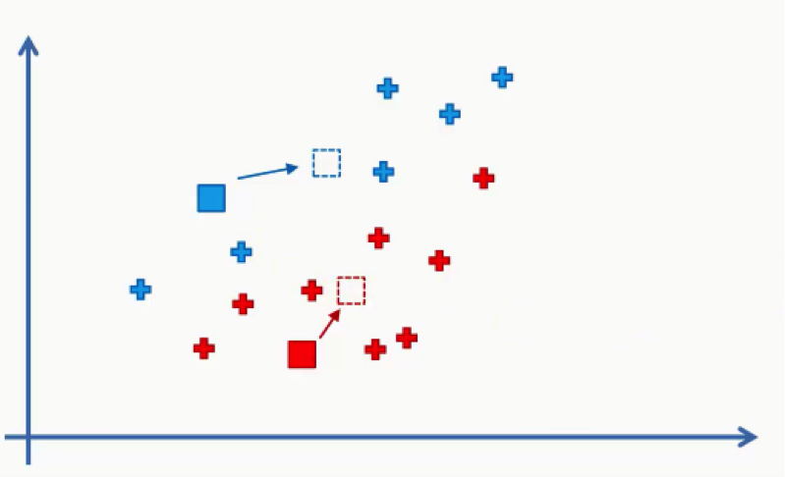
Step Five: Reassign the data points to the centroid that is closest to them now.
If any reassignments actually occur, then you need to go back to step 3 & 4 and repeat until there are no more to be made.
If there aren't any, then that means that you're done with the process and your model is ready.

Slide 40
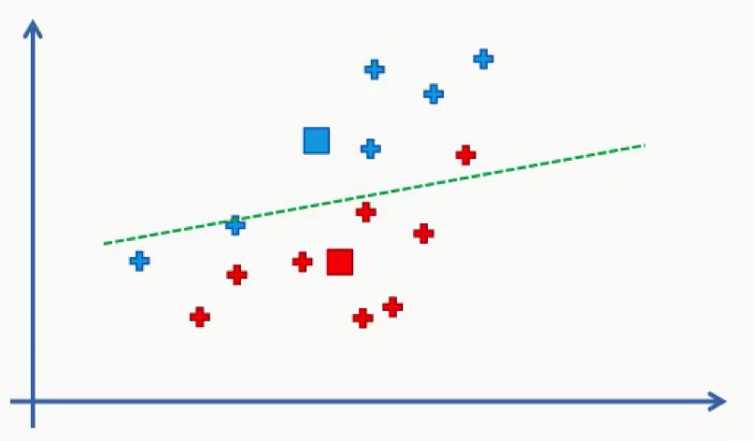
Think of your centroids as weightless points with weighted data points gathered around them.
We need to find and plot the new centroids at the center of each cluster's mass like you see in the figure below.
As you can see, one of the red data points ended up in the blue cluster, and two blue points fell into the red cluster.

Slide 41
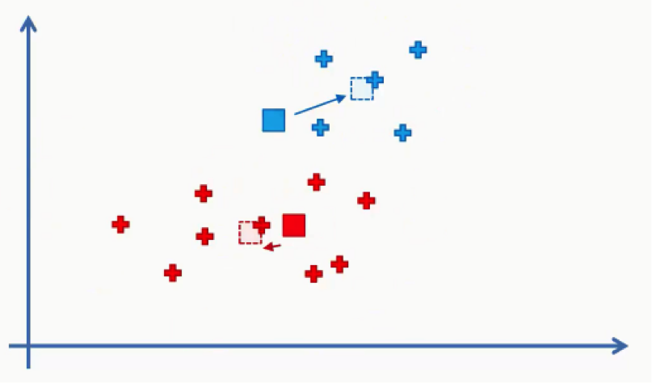
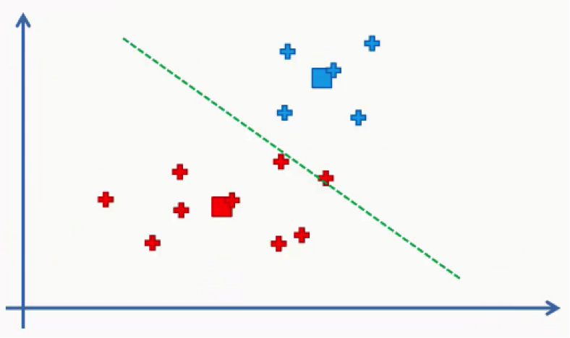
Then we will repeat step 5 by reassigning each data point to its new centroid.
Again, we will end up with one red data point shifting to the blue cluster.
This will take us back to step 4 and we'll keep repeating until there are no more reassignments to be made.

Slide 42
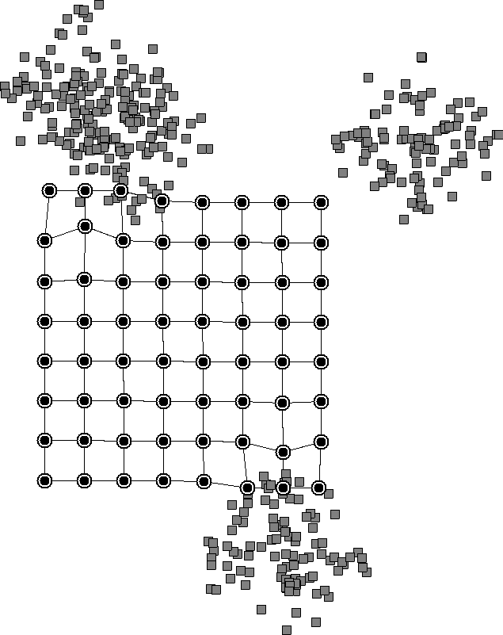
Training process of SOM on a two-dimensional data set

Slide 43
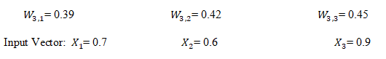
Adjusting the Weights
Every node within the BMU’s neighborhood has its weight vector adjusted according to the following equation:
New Weights = Old Weights + Learning Rate (Input Vector — Old Weights)
W(t+1) = W(t) + L(t) {V(t) — W(t)}
Where “t” represents the time-step and “L” is a small variable called the learning rate, which decreases with time.
So according to our example are Node 4 is Best Match Unit corresponding their weights:

Slide 44
Learning rate = 0.5
So update that weight according to the above equation,
For W_{3,1}
New Weights = Old Weights + Learning Rate (Input Vector1 — Old Weights)
New Weights = 0.39 + 0.5 (0.7–0.39)
New Weights = 0.545
For W_{3,2}
New Weights = Old Weights + Learning Rate (Input Vector2 — Old Weights)
New Weights = 0.42 + 0.5 (0.6–0.42)
New Weights = 0.51
For W_{3,3}
New Weights = Old Weights + Learning Rate (Input Vector3 — Old Weights)
New Weights = 0.45 + 0.5 (0.9–0.45)
New Weights = 0.675
Updated weights:

Slide 45
Variations of SOMs:
A neural gas is a SOM without a static topology:
Neural gas is an artificial neural network, inspired by the self-organizing map and introduced in 1991 by Thomas Martinetz and Klaus Schulten.
The neural gas is a type of self-organizing map that was created to solve the challenge of mapping complex input data that occurs only in subspaces of the input space or even alters the subspace.
In a nutshell, the goal of a neural gas is to create a SOM without a grid framework.
A truly dynamic neighborhood function distinguishes a neural gas from a SOM.

Slide 47
In general, the distance between the neuron and the winner neuron in the input space is used to make this decision.
The learning steps are quite similar to the SOM learning stages because they are developed from t
again, random initialization of
selection and presentation of a pattern of the input space
neuron distance measurement.
identification of the winner neuron i.
Intermediate step: generation of a list L of neurons sorted in ascending order by their distance to the winner neuron.
The first neuron in the list L is the neuron that is closest to the winner neuron.

Slide 48
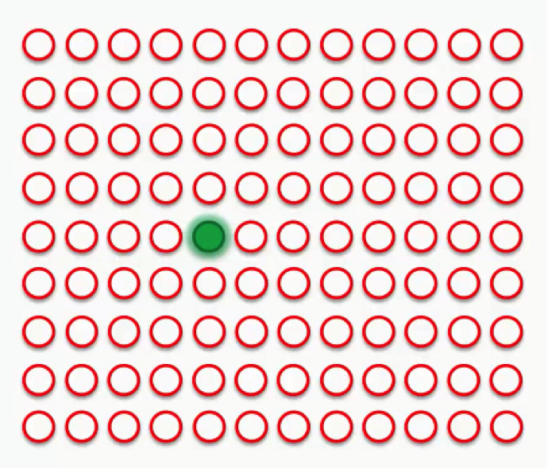
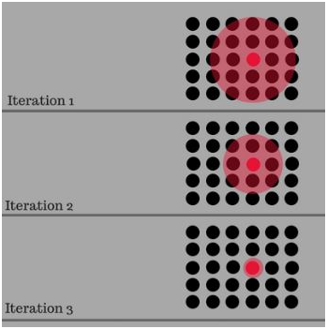
Intermediate step:

Slide 49
Changing the centers by means of the known rule but with the slightly modified topology function
h_{L}(i, k, t)
The function h_{L}(i, k, t), which is slightly modified compared with the original function h(i, k, t), now regards the first elements of the list as the neighborhood of the winner neuron i.
The direct result is that – like the free-floating molecules in a gas – the neighborhood relationships between the neurons can change anytime, and the number of neighbors is almost arbitrary, too.

Slide 50
A Multi-SOM consists of several separate SOMs:
What should we do with input patterns that are known to be limited to a few (perhaps discontinuous) areas?
Here, the idea is to use not only one SOM but several ones.
A multi-self organizing map, shortly referred to as M-SOM.
A multiSOM is nothing more than the simultaneous use of M SOMs.
This learning process is analog to that of the SOMs.
However, only the neurons belonging to the winner SOM of each training step are adapted.
Thus, it is easy to represent two disjoint clusters of data by means of two SOMs, even if one of the clusters is not represented in every dimension of the input space.
Actually, the individual SOMs exactly reflect these clusters.

Slide 51
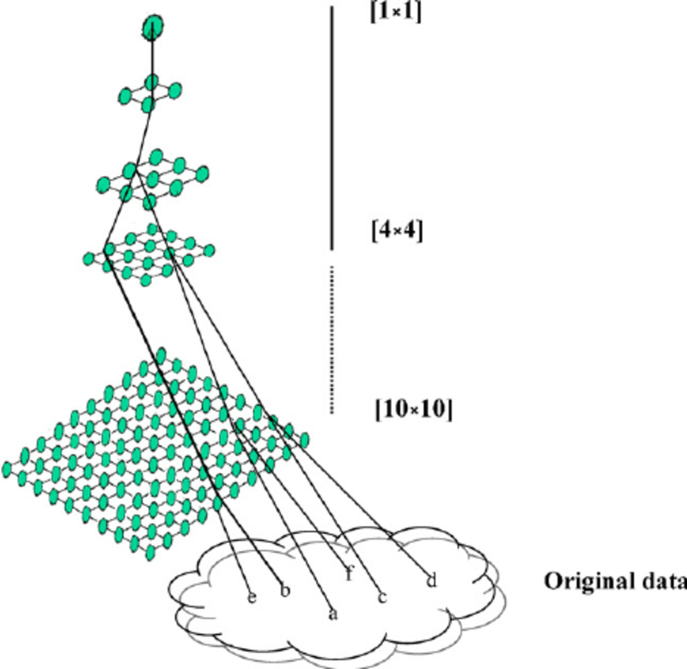

Slide 52
A multi-neural gas consists of several separate neural gases:
Analogous to the multi-SOM, we also have a set of M neural gases.
What advantage is there to use a multi-neural gas since an individual neural gas is already capable to divide into clusters and to work on complex input patterns with changing dimensions?
Basically, this is correct, but a multi-neural gas has two serious advantages over a simple neural gas.
1. With several gases, we can directly tell which neuron belongs to which gas. Simple neural gases can also find and cover clusters, but now we cannot recognize which neuron belongs to which cluster.
2. When huge original gases are broken into numerous smaller ones, a lot of computing work is saved because sorting a single large list L can take a

Slide 53
long time whereas sorting several smaller lists L₁, L₂,..., L_{M} takes less time – even if these lists all have the same number of neurons.
As a result we will only obtain local instead of global sorting, but in most cases these local sorting are sufficient.
We now have two extreme situations of multi-neural gases to choose from: The typical neural gas M = 1, in which we only employ one neural gas, is an extreme instance.
Surprisingly, the second extreme situation (very large M, few or no neurons per gas) responds similarly to K-means clustering.
A multi-neural gas is nothing more than the simultaneous use of M neural gases.

Slide 54
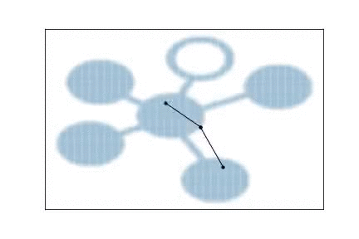
Growing neural gases can add neurons to themselves:
A growing neural gas is a variation of the aforementioned neural gas to which more and more neurons are added according to certain rules.
The Growing Neural Gas (GNG) is an incremental algorithm, where no previous information about the number of clusters is preset.
New units are added according to the training dynamics.
As a result, this is an attempt to avoid the isolation of neurons or the formation of greater holes in the cover.
It's more harder to develop a growing SOM since additional neurons must be integrated into the surrounding area.

Slide 55
Adaptive Resonance Theory (ART)
Adaptive resonance theory is a type of neural network technique.
Developed by Stephen Grossberg and Gail Carpenter in 1987.
The basic ART uses unsupervised learning technique.
They are open to new learning (i.e. adaptive) without discarding the previous or the old information (i.e. resonance).
The ART networks are known to solve the stability-plasticity dilemma.
Stability refers to their nature of memorizing the learning.
Plasticity refers to the fact that they are flexible to gain new information.

Slide 56
Due to this the nature of ART, they are always able to learn new input patterns without forgetting the past.
ART networks implement a clustering algorithm.
Input is presented to the network and the algorithm checks whether it fits into one of the already stored clusters.
If it fits then the input is added to the cluster that matches the most else a new cluster is formed.

Slide 57
Types of Adaptive Resonance Theory:
ART1 – It is the simplest and the basic ART architecture. It is capable of clustering binary input values.
ART2 – It is extension of ART1 that is capable of clustering continuous-valued input data.
ART3 – It is extension of ART2, improves the learning ability.
ARTMAP – It is a supervised form of ART learning where one ART learns based on the previous ART module. It is also known as predictive ART.
FARTMAP – This is a supervised ART architecture with Fuzzy logic included.

Slide 58
Basic of Adaptive Resonance Theory Architecture:
The adaptive resonant theory is a type of neural network that is self-organizing and competitive.
It can be of both types, the unsupervised ones (ART1, ART2, ART3) or the supervised ones (ARTMAP).
Generally, the supervised algorithms are named with the suffix “MAP”.
Human has ability to learn through classification.
Human learn new concepts by relating them to existing knowledge and if unable to relate to something already known, then creates a new structure.
Represents such human like learning ability.

Slide 59
Task and structure of an ART network:
An ART network comprises exactly two layers:
the input layer ‘I’
the recognition layer ‘O’
with the input layer being completely linked towards the recognition layer.
This complete link induces a top-down weight matrix W that contains the weight values of the connections between each neuron in the input layer and each neuron in the recognition layer.
Simple binary patterns are entered into the input layer and transferred to the recognition layer while the recognition layer shall return a
It follows the winner-takes-all scheme.

Slide 60
Resonance takes place by activities being tossed and turned:
There also exists a bottom-up weight matrix V , which propagates the activities within the recognition layer back into the input layer.
These activities are bounced forth and back again and again, a fact that leads us to resonance.
Every activity within the input layer causes an activity within the recognition layer while in turn in the recognition layer every activity causes an activity within the input layer.

Slide 61
The learning process of an ART network:
It is divided to top-down and bottom-up learning.
The two-piece learning procedure of the theory: On the one hand we train the top-down matrix W , on the other hand we train the bottom-up matrix V.
1. Pattern input and top-down learning
When a pattern is entered into the network it causes - an activation at the output neurons and the strongest neuron wins.
Then the weights of the matrix W going towards the output neuron are changed such that the output of the strongest neuron Ω is still enhanced.
2. Resonance and bottom-up learning
The training of the backward weights of the matrix V is a bit tricky.
Only the weights of the respective winner neuron are trained towards the input layer and our current input pattern is used as teaching input.
Thus, the network is trained to enhance input vectors.

Slide 62
3. Adding an output neuron
It's possible that the neurons are equally active or that many neurons are triggered, resulting in a network that is undecided.
In this case, the control neurons' methods activate a signal that causes a new output neuron to be inserted.
The current pattern is then assigned to this output neuron, and the weight settings of the new neuron are trained in the same way as before.
As a result, a key feature of this system is its ability to not only divide inputs into classes and discover new classes, but also to tell us what a typical representative of a class looks like after an output neuron is activated.
However, the algorithm can often only detect patterns to a limited extent.

Slide 63
Extensions:
The ART networks have often been extended.
ART-2 is extended to continuous inputs and additionally offers (in an extension called ART-2A) enhancements of the learning speed which results in additional control neurons and layers.
ART-3 improves the learning ability of ART-2 by adapting additional biological processes such as the chemical processes within the synapses.

Slide 65
